Slide 1
JK Financials’ Sensible Solution

Slide 2
What are some of the Problems/ Concerns you have with Your Current Health Insurance Plan and/or Health Insurance Today in General?
Premiums are too expensive.
Premiums keep going up.
Out of pocket is too high.
Access to my doctors of choice is being limited.
Being taxed by the government if I don’t purchase a plan they approve.
Being forced to purchase coverage for things I may not want or need (Maternity; Mental Health; Pediatric; etc.).
At JK Financial, We Have The Solution
JK Financial…Protecting Your Future…Keeping our Promises!

Slide 3
Additional
Optional
Benefits
Dental
Optical
Disability
Life Insurance
JK FINANCIALS’
“SENSIBLE SOLUTION”
Prescriptions
Provides a substantial discount on both Name Brand and Generic medication.
Accident Coverage
Pays you a cash benefit in the event of an accidental injury to help pay for expenses not covered by your medical plan.
Critical Illness Coverage
Pays you a lump sum cash benefit to cover costs not taken care of by your medical plan (time off work; caregiver expenses; travel costs for treatments; etc.)
Major Medical
Christian Healthcare Ministries (CHM)

Slide 4
About Christian Healthcare Ministries (CHM)
As a religious Co-Op, CHM is exempt from the Affordable Care Act.
CHM has many years experience, since 1981.
You cannot be dropped or denied coverage due to health.
CHM provides worldwide coverage
No networks. You are covered at any hospital; any doctor.
No preauthorization or referrals required.
There are no Contracts between CHM and its members.
This eliminates the “Fine Print” insurance companies often use to deny or reduce payment on claims.
With CHM, there are no “Open Enrollment” periods. Membership enrollment is available year-round.
CHM is not a part of; aligned with; connected to; or associated with; any insurance company.
CHM does not work with any agents.
CHM provides no compensation or commissions to agents for referring members to enroll.
Only members can contact CHM directly..
JK Financial…Protecting Your Future…Keeping our Promises!

Slide 5
Agreement Statement
In order to participate in the CHM program all participating ADULTS must be in agreement and accept the following statement:
“They must attest that the participating ADULT(s) member included in the plan are Christians living by biblical principles, attend group worship regularly (health permitting), follow scriptural teaching with regard to alcohol, and do not use tobacco or use drugs illegally. They also attest that all the information provided is true to the best of their knowledge.”
JK Financial…Protecting Your Future…Keeping our Promises!

Slide 6
CHM Program Comparison
JK Financial…Protecting Your Future…Keeping our Promises!

Slide 7
Critical Illness
Pays a lump-sum benefit of $10 - $100K upon a first occurrence of the qualifying event
or diagnosis listed below, subject to a 30-day waiting period.
Qualifying Event Paid at 100%
Advanced Alzheimer’s, ALS, invasive cancer, coma, heart attack, major organ transplant, stroke, end-stage renal failure, major burns, paralysis.
Qualifying Event Paid at 25%
Benign brain tumor, cancer in situ, coronary artery bypass.
JK Financial…Protecting Your Future…Keeping our Promises!

Slide 8
Accident coverage
BENEFITS (per person, per accidental injury) | Option 1 | Option 2 | Option 3 | Option 4
Hospital Confinement¹ (one per Policy year) | $2,500 | $5,000 | $7,500 | $10,000
Emergency Treatment² (within 72 hours of injury) | $250 per injury | $500 per injury | $750 per injury | $1,000 per injury
Major Diagnostic Exam (one per Policy year at hospital or urgent care center) | $250 | $500 | $750 | $1,000
Follow-up Treatment (up to five visits per Policy year) OR Follow- up Physical Therapy³ (up to five visits per Policy year) | $50 per visit $50 per visit | $100 per visit $100 per visit | $100 per visit $100 per visit | $100 per visit $100 per visit
¹ Hospital confinement must begin within 30 days of the accident ² Treatment in Emergency Room or Urgent Care Facility ³ Benefits following Emergency Room or Urgent Care treatment and therapy provided within 30 days of initial onset. Follow-up treatment and physical therapy received on the same day will only receive one benefit.

Slide 9
The “good rX” prescription plan
Save substantially on the high cost of prescriptions...
Both Name Brand and Generic!
It’s FREE and easy to use!
Go to: goodrx.com
Type in your medication
A list of all local pharmacies will be displayed with their negotiated price for that medication. You can go to your regular pharmacy or possibly save money by choosing a different location.
Print off the coupon and take it with you.
Or…
Simply download the phone app and take it to the pharmacy with you.
JK Financial…Protecting Your Future…Keeping our Promises!

Slide 10
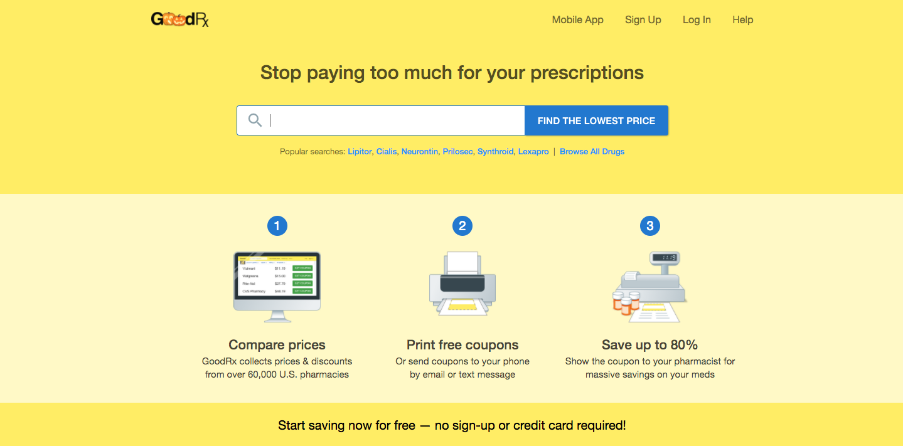
The “good rX” prescription plan
JK Financial…Protecting Your Future…Keeping our Promises!

Slide 11
The Claims process
Complete the following steps when filing a claim with Christian Healthcare Ministries (CHM):
Inform them that you are a “Cash Patient” who works with CHM. (They will most likely be familiar with them and the process)
Request a discount as a cash patient. This is normal and helps expedite the claim being processed.
Request the bills be itemized and aggregated then sent directly to you.
Once received, forward the itemized bill which should include: Name; Date of Service; Treatment Description; and Charges; To CHM, along with the following:
Needs processing form
Medical release form
A brief letter describing the medical situation
Approximate claims processing time is 90 days.
Filing a claim for any of the supplemental benefits simply requires you to forward the itemized billing along with the appropriate claim form.
JK Financial…Protecting Your Future…Keeping our Promises!

Slide 12
JK Financial * 410 Berry Patch Lane, White Lake, MI 48386 * 248-242-6193
Visit our website at: JKFinancialGroup.com
JK Financial…Protecting Your Future…Keeping our Promises!

