Slide 1
JK Financials’ Affordable Solution

Slide 2
What are some of the Problems/ Concerns you have with Your Current Health Insurance Plan and/or Health Insurance Today in General?
Premiums are too expensive.
Premiums keep going up.
Out of pocket is too high.
Access to my doctors of choice is being limited.
Being taxed by the government if I don’t purchase a plan they approve.
Being forced to purchase coverage for things I may not want or need (Maternity; Mental Health; Pediatric; etc.).
At JK Financial, We Have The Solution
JK Financial…Protecting Your Future…Keeping our Promises!

Slide 3
Additional
Optional
Benefits
Dental
Optical
Disability
Life Insurance
JK FINANCIALS’
“AFFORDABLE SOLUTION”
Prescriptions
Provides a substantial discount on both Name Brand and Generic medication.
Accident Coverage
Pays you a cash benefit in the event of an accidental injury to help pay for expenses not covered by your medical plan.
Critical Illness Coverage
Pays you a lump sum cash benefit to cover costs not taken care of by your medical plan (time off work; caregiver expenses; travel costs for treatments; etc.)
Major Medical
One Share Health

Slide 4
Statement of Beliefs
We believe in the sanctity and dignity of every human life, and that every life has a special meaning and purpose.
We believe that every individual has the constitutional and religious right to worship God in freedom.
We believe and agree in the religious and ethical principal of sharing with those who are less fortunate and who experience medical needs.
We believe that every person has the fundamental right to make their own choices about healthcare.
We believe and agree that it is our responsibility to God to our fellow members to engage in healthy living, and to avoid habits and behaviors which are harmful to the body.

Slide 5
One Share Health Classic Programs Multiplan PHCS Network: One Share Health provides you access to the largest PPO network in the nation with over 1 million providers!
Sharing Services | Enhanced | Crown
Preventive Services | $0 Visit Fee | $0 Visit Fee
Primary Care Physician, Pediatric, OB/GYN¹ | 3 Per Year - $20 Visit Fee | 5 Per Year - $20 Visit Fee
Urgent Care Facility | 1 Per Year -$20 | 2 Per Year - $20
X-Rays | PCP/Urgent Care | PCP/Urgent Care
Labs/Diagnostic | PCP/Urgent Care | PCP/Urgent Care
Specialists | Not Eligible | $75 Visit Fee²
Telemedicine³ | $0 consult Fee | $0 Consult Fee
Emergency Room | $500 Visit Fee | $300 Visit Fee
Maternity | Not Eligible | $5,000³ Maximum Sharing
In/Out Patient Surgery | Eligible | Eligible
Hospitalization | Eligible | Eligible
Maximum Limit Per Incident | $250,000 | $500,000
Lifetime Sharing Maximum | $1,000,000 | $1,000,000
End of Life Sharing | Primary Member $6,000. If program includes Spouse and/or Dependents. Spouse $4,000 | Dependent $2,000
Eligible sharing services is subject to ISA. See disclosure for full details of Sharing Services. ¹OB/GYN for well woman visits only.
²$75 until ISA is met, then 100% sharing. ³Natural Delivery, see Maternity.

Slide 6
100 %
Preventative Services
USPSTF
Evidence based items or services rated A or B in the united States Preventative Services
Task Force recommendations.
Recommendations of the Advisory Committee on Immunization Practices adopted by
The director of the Centers for Disease Control and Prevention;
Comprehensive guidelines for infants, children, and adolescents supported by the
Health Resources and Services Administration (HRSA); and Comprehensive
guidelines for women supported by the Health Resources and Services Administration (HRSA)
CHILDREN
Alcohol and Drug Use Assessment
Autism Screening
Behavior Assessment
Blood Pressure Screening
Cervical Dysplasia Screening
Congenital Hypothyroidism Screening
Depression Screening
Height, Weight, Body Mass Index Measurements
Hematocrit/Hemoglobin Screening
Hemoglobinopathies/ Sickle Cell Screening
HIV Screening
Lead Screening
Obesity Screening/ Counseling
Phenylketonuria Screening
STI Counseling/Screening
Tuberculin Testing
Immunizations
And Injections
DtaP
Hemophilus
Hepatitis A, B
Herpes Zoster
Human Papillomavirus
Inactivated Poliovirus
Influenza
Influenza Type B
Measles, Mumps, Rubella
Meningococcal
Pneumococcal
Rotavirus
Tetanus
Varicella
Woman
Anemia Screening
Bacteriuria & Urinary Tract Infection
BRCA Counseling
Breast Cancer Screening
Breast Cancer Chemoprevention Counseling
Cervical Cancer Screening
Chlamydia Infection Screening
Contraception Counseling
Domestic Violence
Counseling/Screening
Gestational Diabetes Screening
Gonorrhea Screening
HPV Testing, every 3 year
Tobacco Screening/ Counseling
STI Counseling
Syphilis Screening
Adults
Blood Pressure Screening
Cholesterol Screening
Colorectal Cancer Screening
Depression Screening
Type II Diabetes Screening
Diet Counseling
HIV Screening

Slide 7
Additional
Optional
Benefits
Dental
Optical
Disability
Life Insurance
JK FINANCIALS’
“AFFORDABLE SOLUTION”
Prescriptions
Provides a substantial discount on both Name Brand and Generic medication.
Accident Coverage
Pays you a cash benefit in the event of an accidental injury to help pay for expenses not covered by your medical plan.
Critical Illness Coverage
Pays you a lump sum cash benefit to cover costs not taken care of by your medical plan (time off work; caregiver expenses; travel costs for treatments; etc.)
Major Medical
One Share Health

Slide 8
Critical Illness
Pays a lump-sum benefit of $10 - $100K upon a first occurrence of the qualifying event
or diagnosis listed below, subject to a 30-day waiting period.
Qualifying Event Paid at 100%
Advanced Alzheimer’s, ALS, invasive cancer, coma, heart attack, major organ transplant, stroke, end-stage renal failure, major burns, paralysis.
Qualifying Event Paid at 25%
Benign brain tumor, cancer in situ, coronary artery bypass.
JK Financial…Protecting Your Future…Keeping our Promises!

Slide 9
Additional
Optional
Benefits
Dental
Optical
Disability
Life Insurance
JK FINANCIALS’
“AFFORDABLE SOLUTION”
Prescriptions
Provides a substantial discount on both Name Brand and Generic medication.
Accident Coverage
Pays you a cash benefit in the event of an accidental injury to help pay for expenses not covered by your medical plan.
Critical Illness Coverage
Pays you a lump sum cash benefit to cover costs not taken care of by your medical plan (time off work; caregiver expenses; travel costs for treatments; etc.)
Major Medical
One Share Health

Slide 10
Accident coverage
BENEFITS (per person, per accidental injury) | Option 1 | Option 2 | Option 3 | Option 4
Hospital Confinement¹ (one per Policy year) | $2,500 | $5,000 | $7,500 | $10,000
Emergency Treatment² (within 72 hours of injury) | $250 per injury | $500 per injury | $750 per injury | $1,000 per injury
Major Diagnostic Exam (one per Policy year at hospital or urgent care center) | $250 | $500 | $750 | $1,000
Follow-up Treatment (up to five visits per Policy year) OR Follow- up Physical Therapy³ (up to five visits per Policy year) | $50 per visit $50 per visit | $100 per visit $100 per visit | $100 per visit $100 per visit | $100 per visit $100 per visit
¹ Hospital confinement must begin within 30 days of the accident ² Treatment in Emergency Room or Urgent Care Facility ³ Benefits following Emergency Room or Urgent Care treatment and therapy provided within 30 days of initial onset. Follow-up treatment and physical therapy received on the same day will only receive one benefit.

Slide 11
Additional
Optional
Benefits
Dental
Optical
Disability
Life Insurance
JK FINANCIALS’
“AFFORDABLE SOLUTION”
Prescriptions
Provides a substantial discount on both Name Brand and Generic medication.
Accident Coverage
Pays you a cash benefit in the event of an accidental injury to help pay for expenses not covered by your medical plan.
Critical Illness Coverage
Pays you a lump sum cash benefit to cover costs not taken care of by your medical plan (time off work; caregiver expenses; travel costs for treatments; etc.)
Major Medical
One Share Health

Slide 12
The “good rX prescription plan
Save substantially on the high cost of prescriptions...
Both Name Brand and Generic!
It’s FREE and easy to use!
Go to: goodrx.com
Type in your medication
A list of all local pharmacies will be displayed with their negotiated price for that medication. You can go to your regular pharmacy or possibly save money by choosing a different location.
Print off the coupon and take it with you.
Or…
Simply download the phone app and take it to the pharmacy with you.
JK Financial…Protecting Your Future…Keeping our Promises!

Slide 13
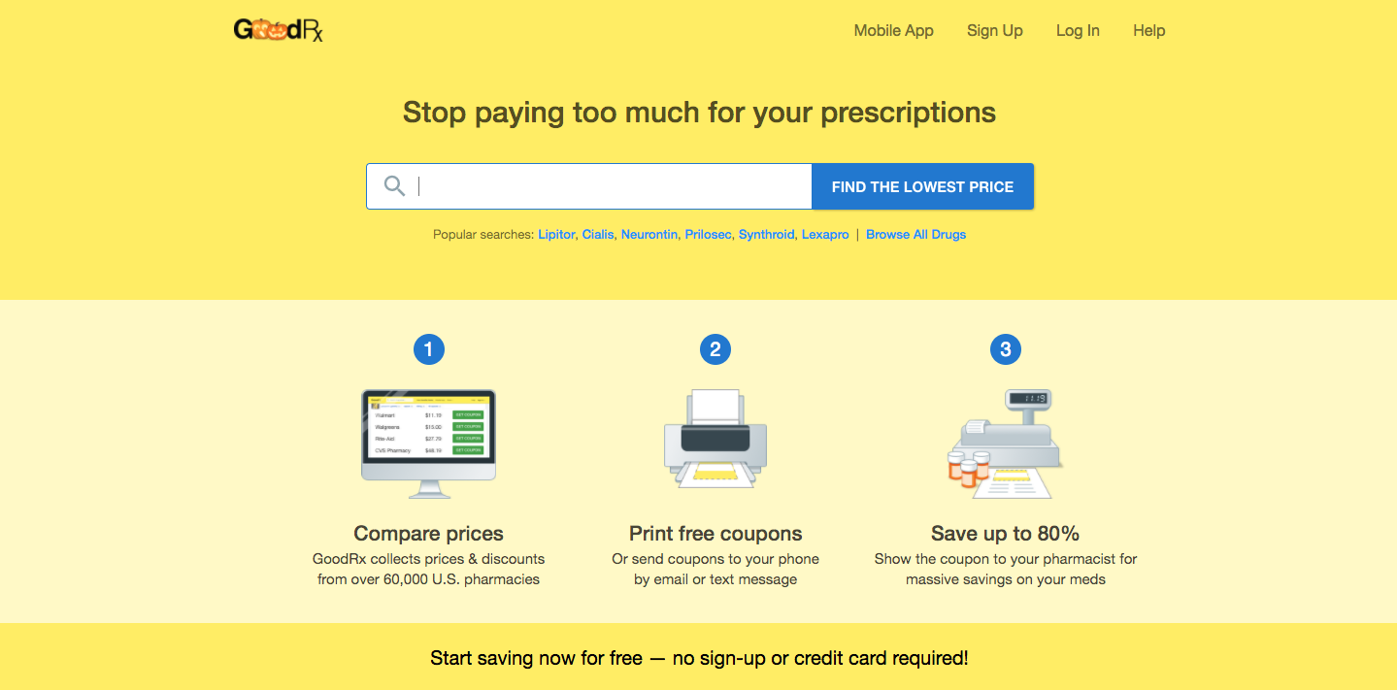
The “good rX” prescription plan
JK Financial…Protecting Your Future…Keeping our Promises!

Slide 14
JK Financial * 410 Berry Patch Lane, White Lake, MI 48386 * 248-242-6193
Visit our website at: JKFinancialGroup.com
JK Financial…Protecting Your Future…Keeping our Promises!

